Slide 1
Time Series Analysis – Sales Forecasting
Presentation by Rohan Mitra

Slide 2
Time Series Analysis
Analysis of data that varies with time
Dependent on previous time steps
Can see trends – seasonality
Can be influenced by external factors

Slide 3
Importance of Sales Forecasting
Setting targets
Cashflow prediction
Inventory analysis
Risk management
Strategic planning

Slide 4
Time Series Analysis – Classical Approaches
Moving Averages
Exponential Smoothing
ARIMA (Autoregressive Integrated Moving Average)
SARIMA (Seasonal Autoregressive Integrated Moving Average)

Slide 5
Time Series Analysis – Machine Learning Approaches
DARTS library
Prophet model
TSAI library
Tensorflow

Slide 6
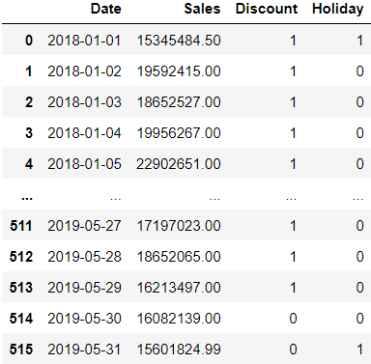
Our Case Study
Your client, GMart, is a leading nutrition and supplement retail chain that offers a comprehensive range of products for all your wellness and fitness needs.
They want to predict their daily sales to manage their cashflow, inventory, and set realistic sales targets
They’ve hired you to help them!
They don’t have extensive data, but have provided you with something to work with
Ref: https://www.kaggle.com/datasets/sureshmecad/supplement-sales-prediction

Slide 7
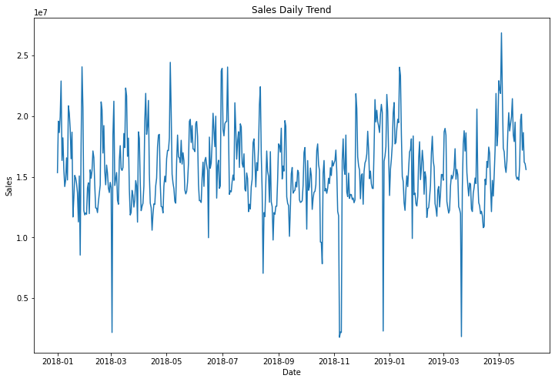
How is GMart doing?

Slide 8

Diagnostics – Autocorrelation Plot
Lag: Previous days (eg: Lag of 1 = 1 day ago)
Correlation between lags, is called autocorrelation (correlation of the Sales with itself)
Autocorrelation plot tells us sales from how many days ago effect today’s prediction
Also dependent on the days in between – 7 days ago AND the last week

Slide 9
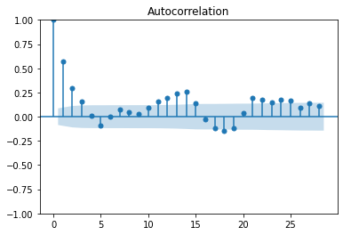
Diagnostics – Autocorrelation Plot
There is seasonality since there is a pattern every ~10 days (weak)
Autocorrelation with lags of 1,2,3,11,12,13,14,15,18,21,22,23,24,25 days
>5% significance (outside blue region)
Hence, we could use any of these to predict the future

Slide 10
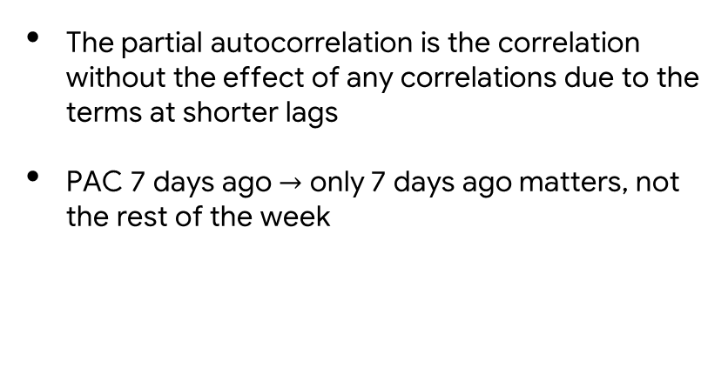
Diagnostics – Partial Autocorrelation Plot
Editable Location
The partial autocorrelation is the correlation without the effect of any correlations due to the terms at shorter lags
PAC 7 days ago $→$ only 7 days ago matters, not the rest of the week

Slide 11
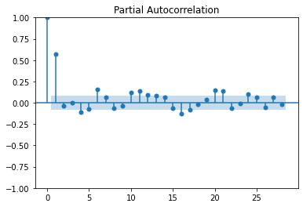
Diagnostics – Partial Autocorrelation Plot
Lags of 1,4,6,10,11,12,16,17,20, 21,24 days have significant PAC
NOT dependent on autocorrelation from other lags in between
Could be better for prediction with less features

Slide 12

Diagnostics – Dickey-Fuller
Editable Location
Is my data stationary?
Does the data have any significant trends?
If p-value < 0.05 → data is stationary
Else data is NOT stationary
Matters mainly for classical approaches (assumptions)
For ML approaches: Need to try both

Slide 13
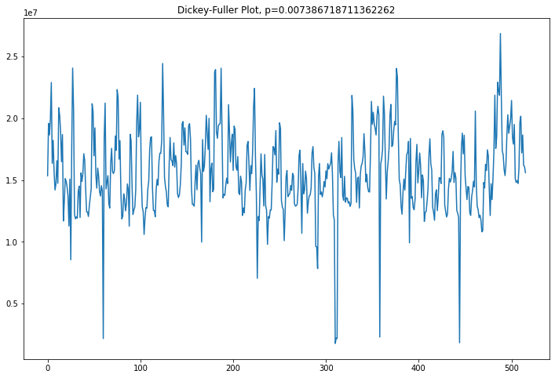
Diagnostics – Dickey-Fuller
P value = 0.00739 < 0.05
Data IS stationary
Constant variance over time - No major seasonality

Slide 14
Diagnostics – Dickey-Fuller
Editable Location
Convert from non-stationary to stationary – take differences
1st difference: Predict how much my sales will increase/decrease by
2nd difference: Predict how much change the increase or decrease in sales will be by - like 2nd derivative
Difference can be taken based on lags identified earlier

Slide 15
Time Series Feature Engineering
Editable Location
Adding features we know at prediction time to the input (eg: Advertising spend)
Experience:
Day of the week
Week of the year
Week of the month
Helps emphasize seasonality

Slide 16
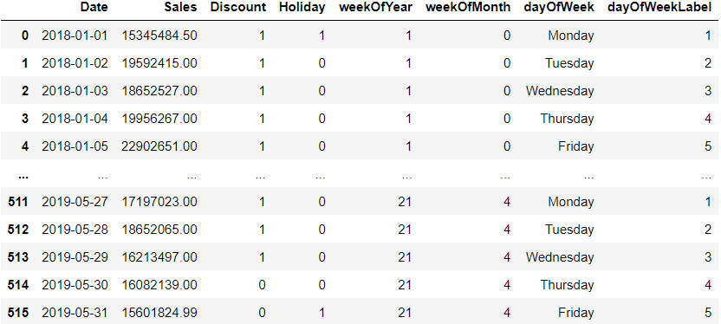
Time Series Feature Engineering – Updated Dataset
Editable Location

Slide 17
Example with DARTS

Slide 18
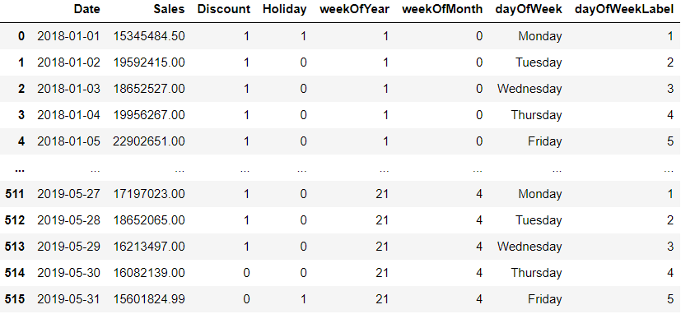
Final Dataset

Slide 19
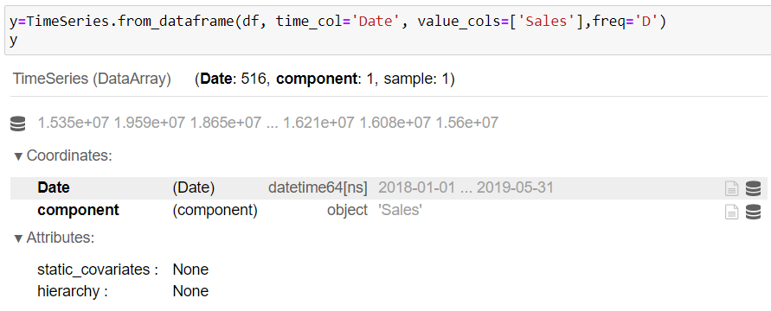
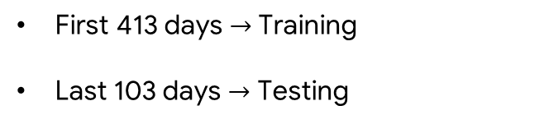
Train-Test Split
First 413 days $→$ Training
Last 103 days $→$ Testing

Slide 20
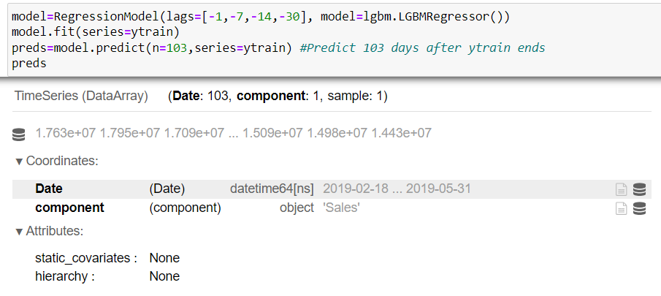
Use the sales from 1, 7, 14, and 30 days ago to predict tomorrow’s sales

Slide 21
Input data after going through DARTS with lags -1,-2,-3,-4
Today | 1 day ago Sales | 2 days ago Sales | 3 days ago Sales | 4 days ago Sales
1-1-18 | 10m | … | … | …
2-1-18 | 12m | 10m | … | …
3-1-18 | 15m | 12m | 10m | …
4-1-18 | 17m | 15m | 12m | 10m
…

Slide 22
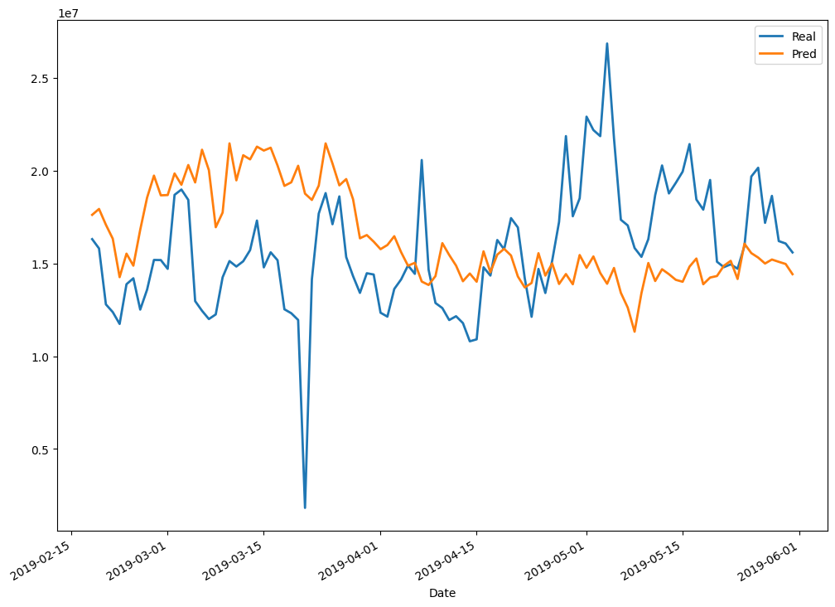
Actual vs Predicted Sales

Slide 23
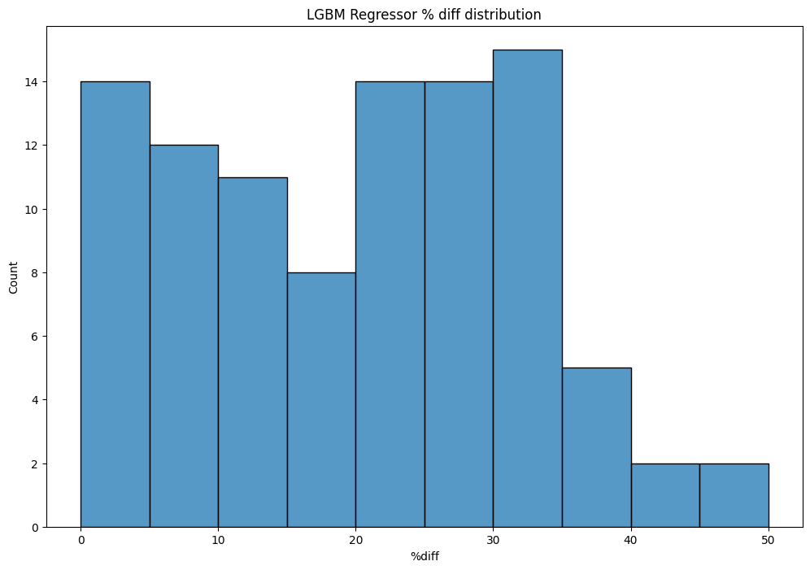
Actual vs Predicted Sales - % difference

Slide 24
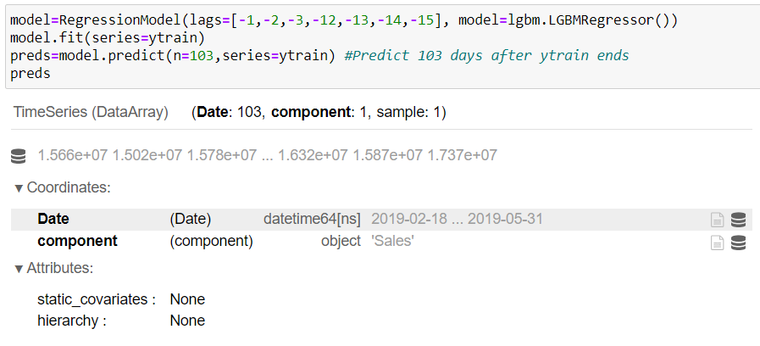
Use the lags we identified as significant by autocorrelation plot!

Slide 25
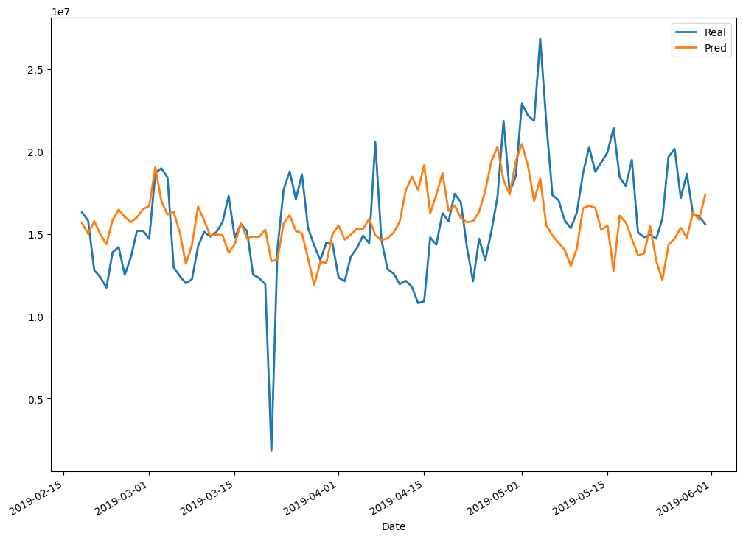
Actual vs Predicted Sales

Slide 26
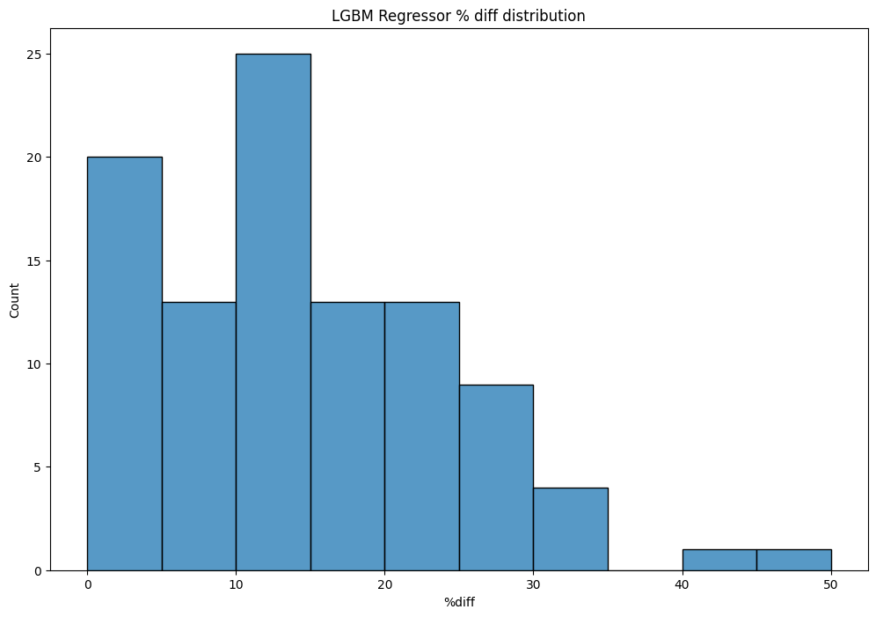
Actual vs Predicted Sales - % difference

Slide 27
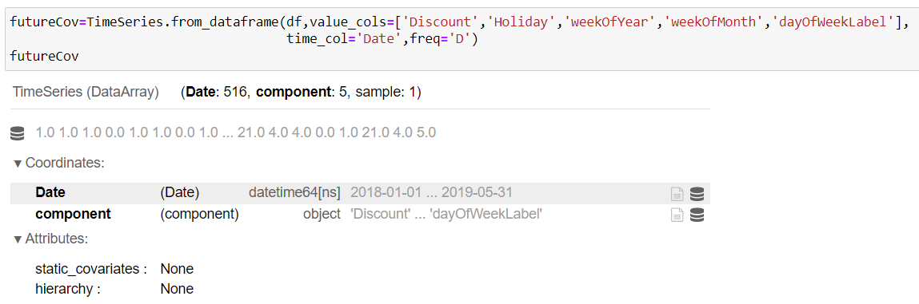
Add other features (Covariates)

Slide 28
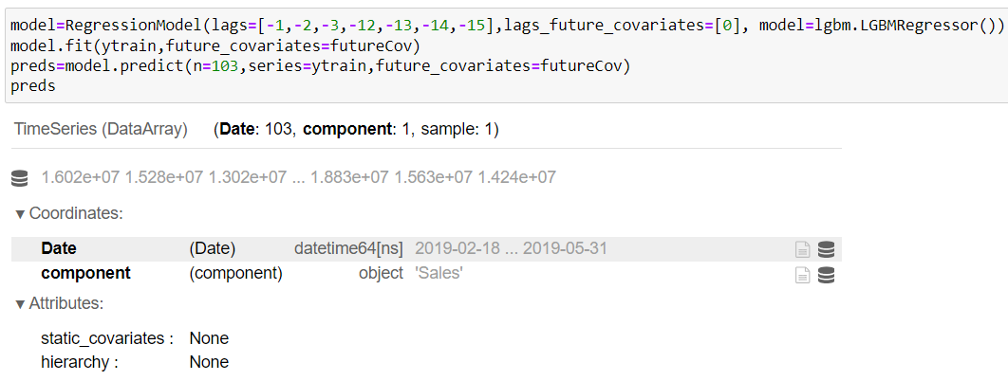
Add other features (Covariates)

Slide 29
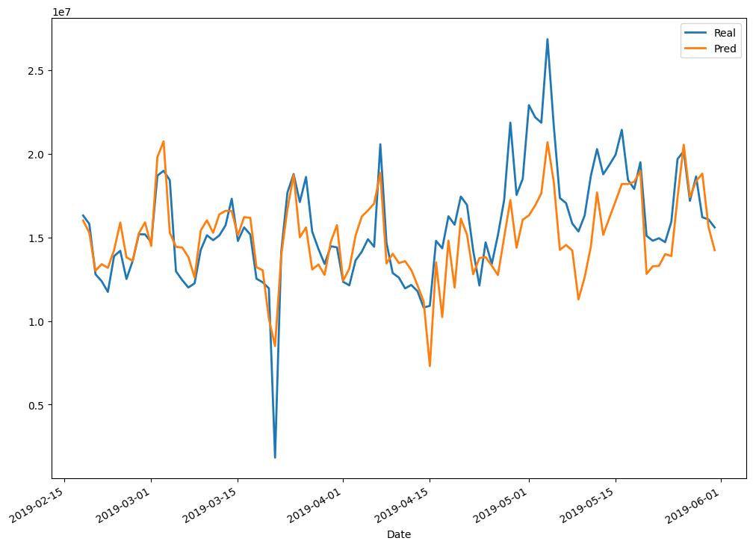
Actual vs Predicted Sales

Slide 30
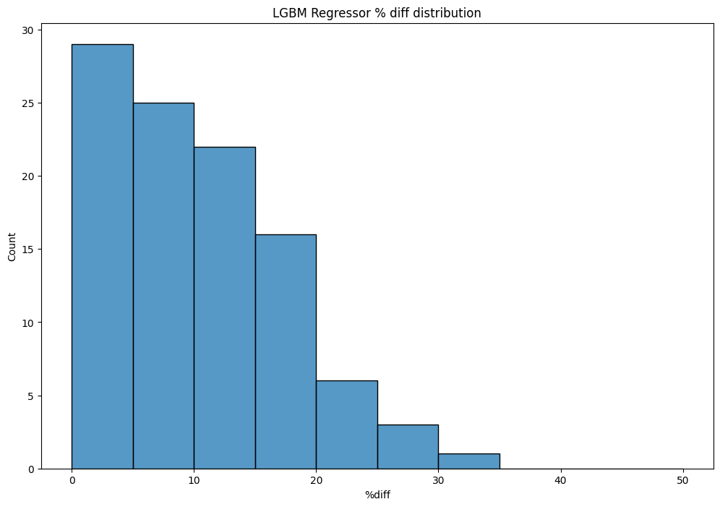
Actual vs Predicted Sales - % difference

Slide 31
Example with Prophet

Slide 32
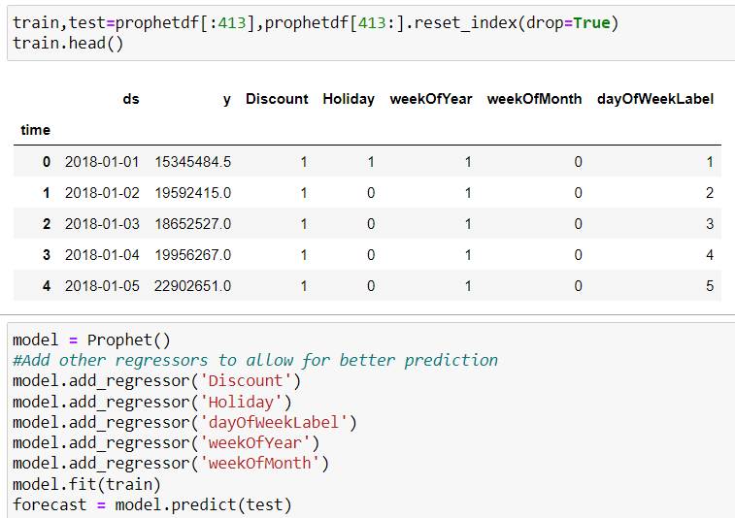
Prepare Data & Train Model

Slide 33
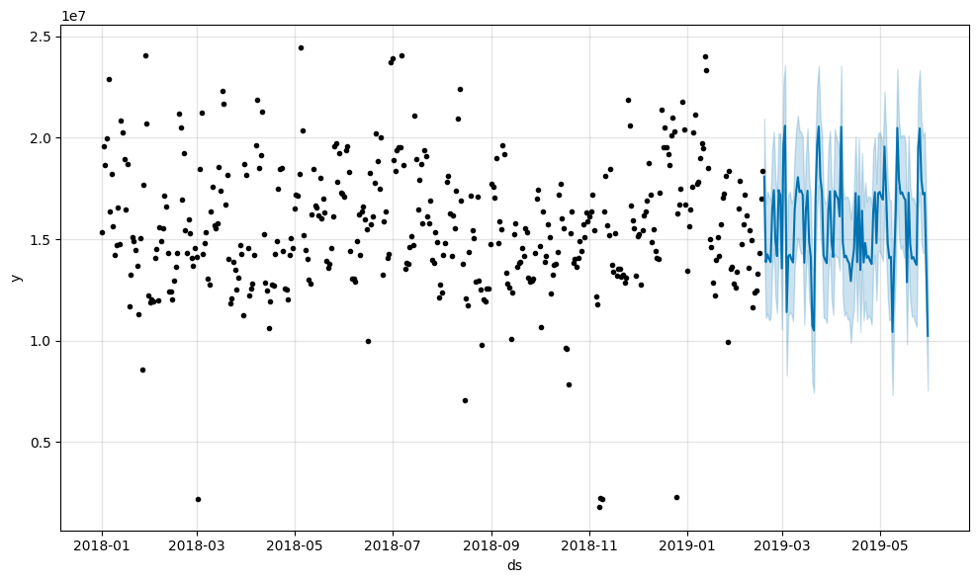
Plot Predictions

Slide 34
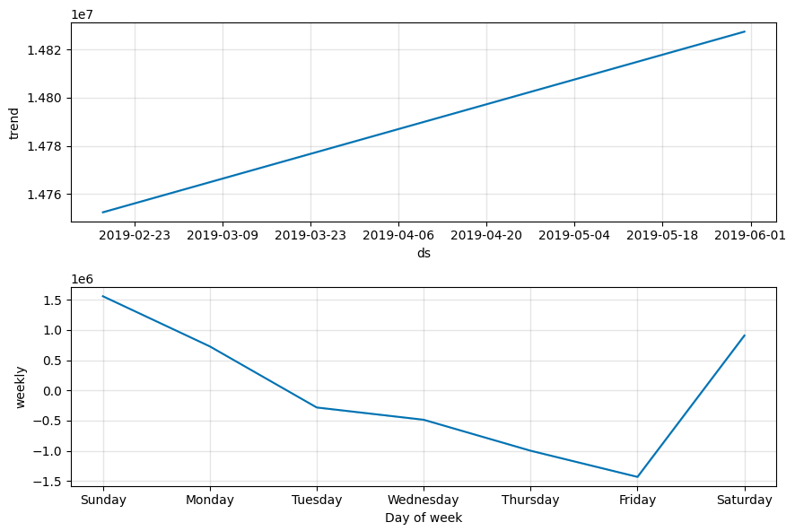
Explain the model

Slide 35
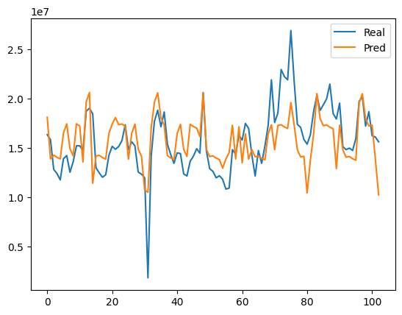
Actual vs Predicted Sales

Slide 36
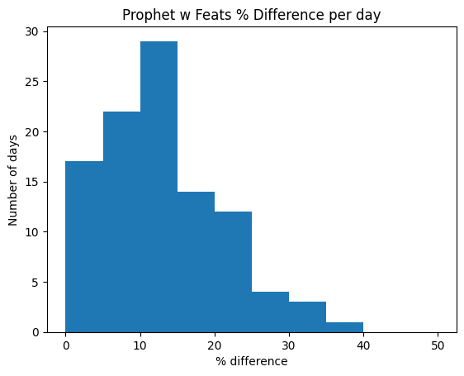
Actual vs Predicted Sales - % difference

Slide 37




Thank You!
https://www.linkedin.com/in/rohan-mitra14/
https://github.com/ro1406
https://orcid.org/my-orcid?orcid=0000-0002-8007-5437
https://github.com/ro1406/SalesPrediction

